Slide 1
Genome Analyses Project
Paper 5- Scaffold 6
Jiarong Liang

Slide 2
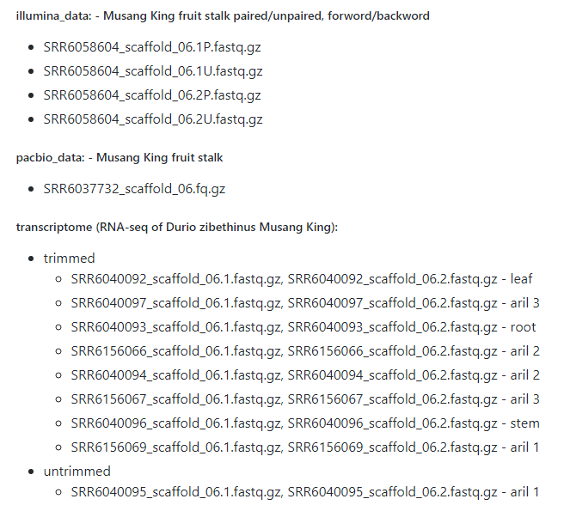
Data Used
DNA-Illumina
DNA-Pacbio
RNA-untrimmed (aril)
RNA-trimmed
(leaf aril root stem)

Slide 3
Workflow
Reads quality control
Genome Assembly
Transcriptome Assembly
Annotation
Statistical analyses

Slide 4
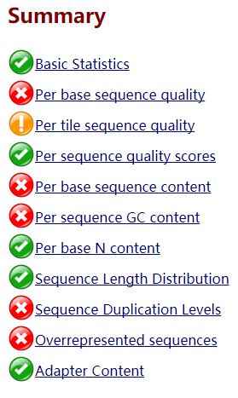
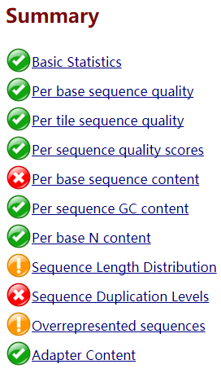
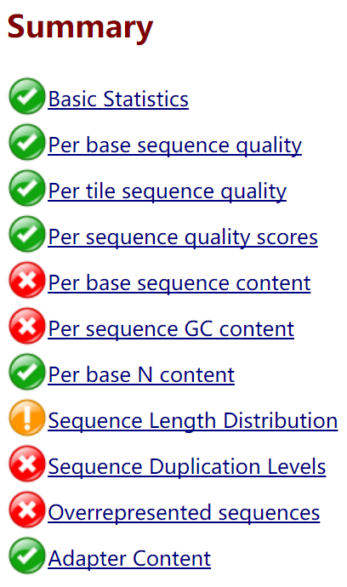
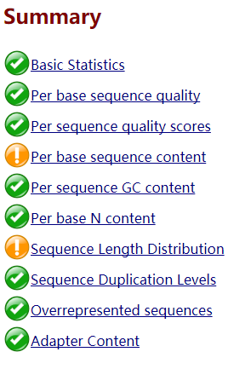
Result – Reads trimming and Quality check
Untrimmed
Provided Trimmed
My Trimmed
DNA’s Illumina

Slide 5
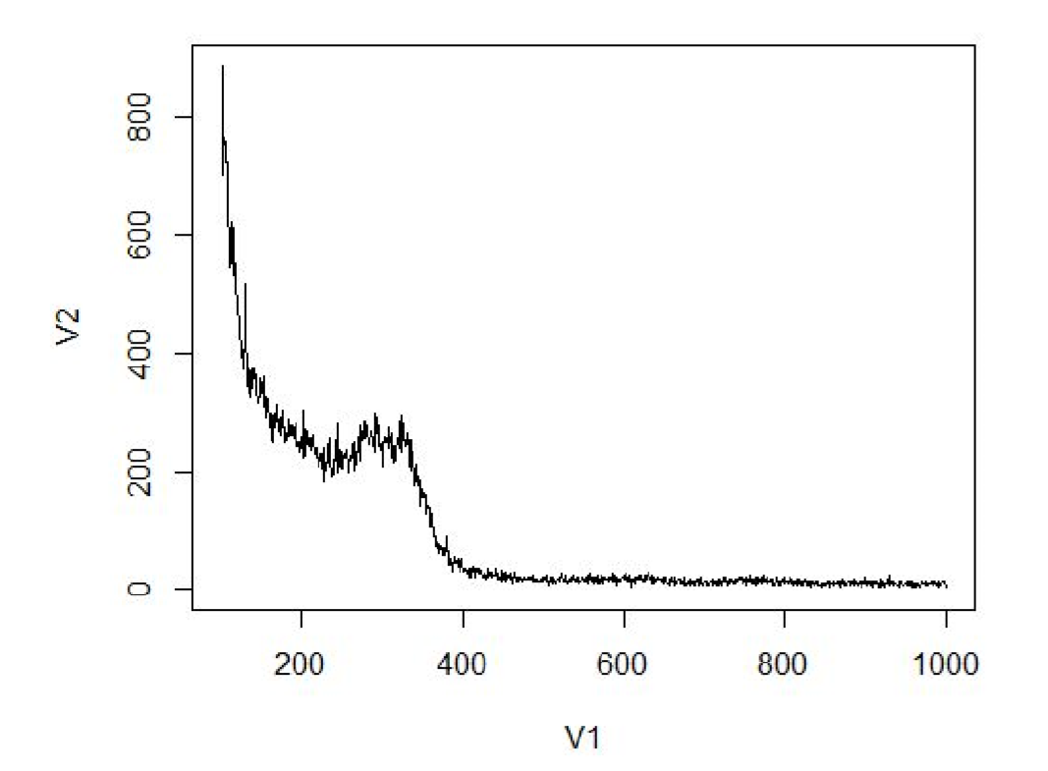
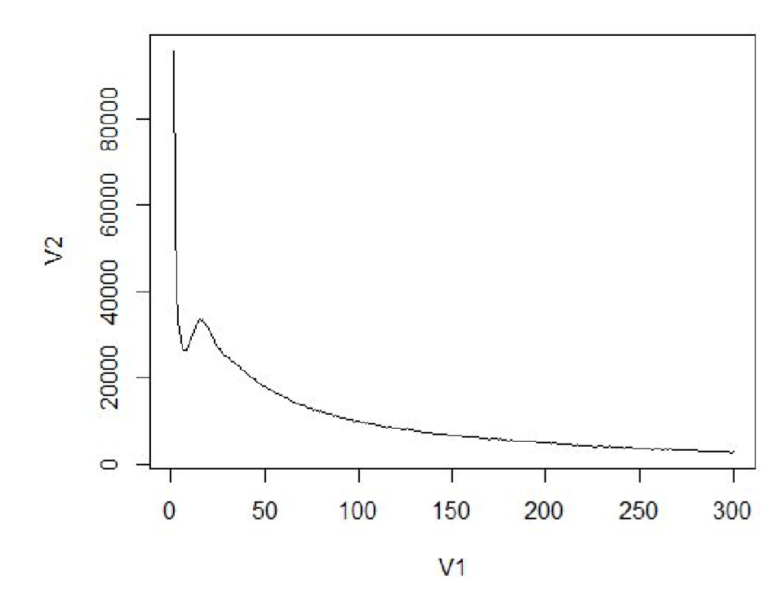
Result – K-mer NOT GOOD
K=31, Predict size: 0.3 M
Paper:27M
K=11, Predict size: 70.9 M

Slide 6
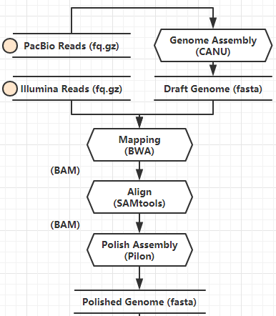
Result – Genome Assembly & Polish
CANU’s draft genome has 659 contigs, total length 35452764 bp
Pilon didn’t improve the assembly quality
97.40% reads mapped back to genome
Assembly file: a fasta file

Slide 7
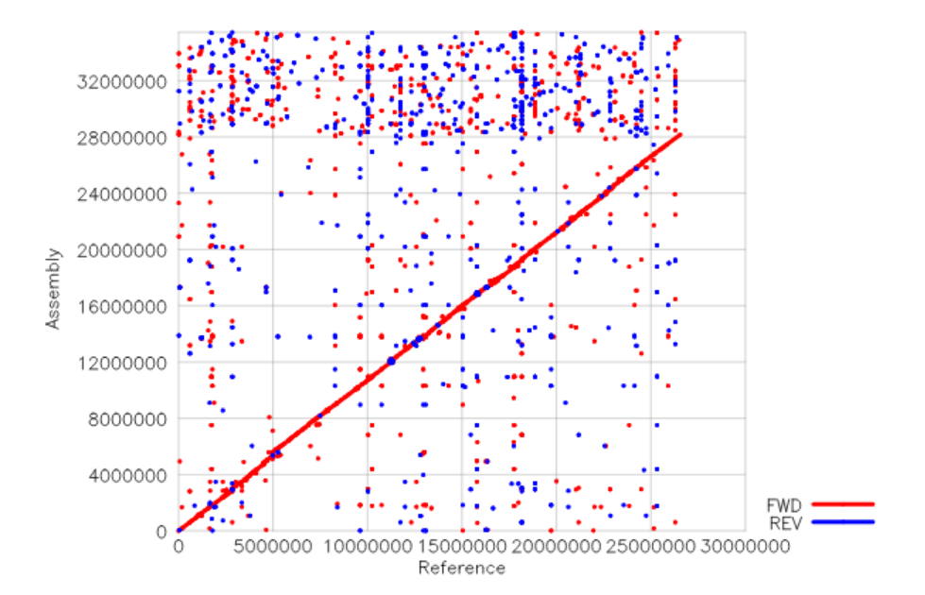
Result – Genome Assembly quality
Not good
QUAST

Slide 8
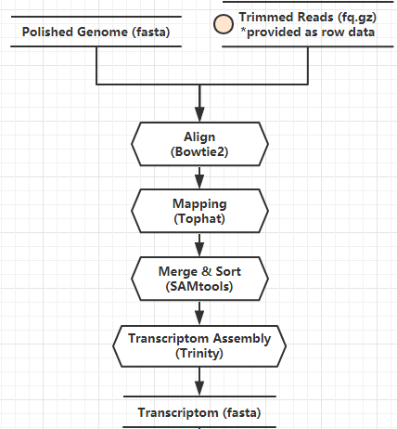
Result – Transcriptome Assembly
90%-95% reads mapped to genome’s assembly
Assembly file: a fasta file
N50: 3145
Fail to compare with paper

Slide 9
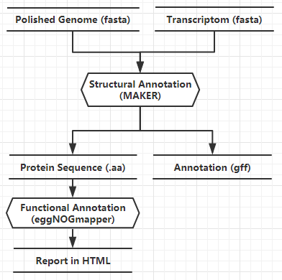
Result - Annotation
Fail to do training (snaphmm & AUGUSTUS)
Use tools to grep possible protein sequence from gff for functional annotation

Slide 10
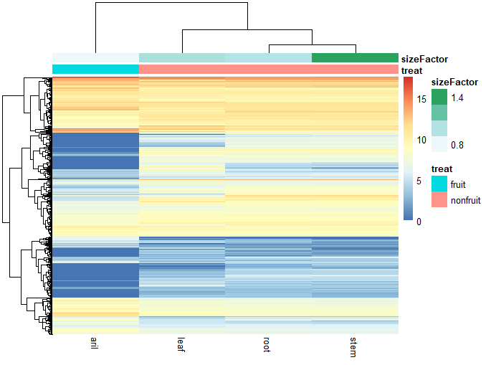
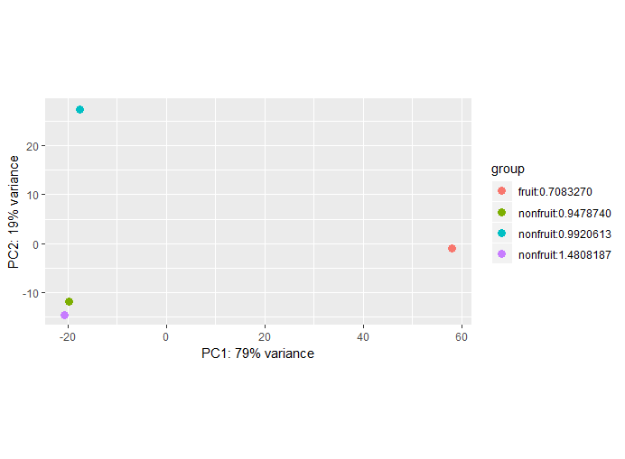
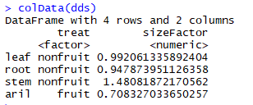
Result - Statistical analyses

Slide 11
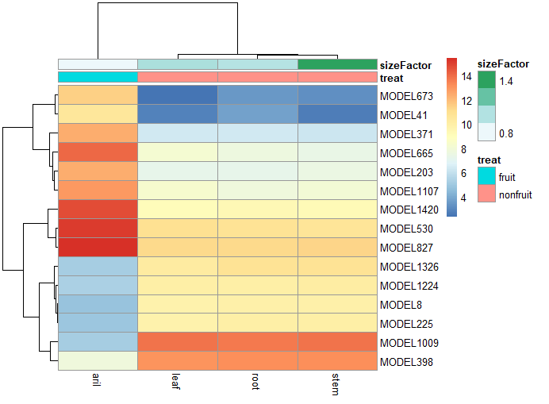
Result - Statistical analyses
673 |Plant invertase/pectin methylesterase inhibitor
41 |?
371 |no match
665 |cytochrome P450
203 |Nuclear pore complex protein
1107 |NAC domain-containing protein
1420 |glutamate--cysteine ligase
530 |no match
827 |Nucleoside diphosphate kinase
1326 |caffeic acid
1224 |no match
8 |disease resistance protein
225 |60S ribosomal protein
1009 |Abscisic acid 8'-hydroxylase
398 |jumonji domain protein
Protein to regulate gene expression &
Enzyme for metabolism

Slide 12
Result – Some Shared Genes
serine threonine-protein phosphatase
Vesicle-associated membrane family protein
RNA recognition motif. (a.k.a. RRM, RBD, or RNP domain)
Hydroxyproline-rich glycoprotein family protein
30S ribosomal protein
Cytochrome p450
Protein of unknown function (DUF1336)
heat shock protein
zinc finger protein
66 kDa stress
Conserved molecular structure/protein
Basic metabolic
Resistance of stress environment

Slide 13
Biological Interpretation
In fruit and non-fruit part of Durian:
Different gene expression ->
Different metabolic pathway ->
Different composition
Different function -> different gene
Metabolic rate -> expression level
Shared express: Majority, basic metabolic functions
!! It’s just a scaffold, and lots of errors in my result

Slide 14
Thanks/Questions?

